Slide 1
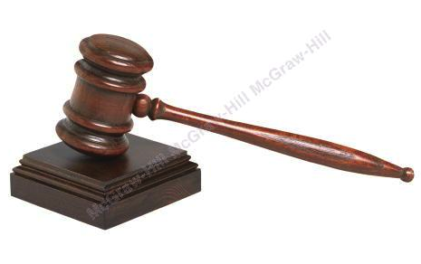
Ethics and Ethical Reasoning
Chapter 5
Copyright ©2020 McGraw-Hill Education. All rights reserved. Authorized only for instructor use in the classroom. No reproduction or further distribution permitted without the prior written consent of McGraw-Hill Education.

Slide 2
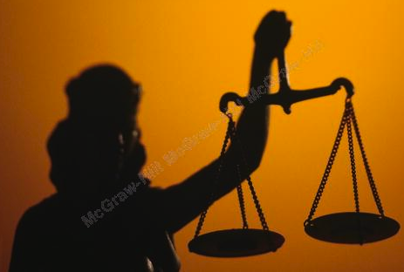
The Meaning of Ethics
Ethics:
Ethical Principles:
Notes:
Ethics:
A conception of right and wrong conduct.
Tells us whether our behavior is moral or immoral.
Deals with fundamental human relationships—how we think and behave toward others and want them to think and behave toward us.
Ethical Principles:
Guides to moral behavior.

Slide 3

Sources of Ethics
Notions of right and wrong come from many sources:
  Acts as a moral compass to guide an individual when ethical dilemmas arise.
Ethical Relativism
Notes:
Notions of right and wrong come from many sources:
Religious beliefs.
Family institution.
Education.
Community/neighborhood.
Media influences.
Acts as a moral compass to guide an individual when ethical dilemmas arise.
Ethical relativism
Concept which holds that ethical behavior should be defined by various periods in time in history, a society’s traditions, the special circumstances of the moment, or personal opinion.
Relative to time, place, circumstance, and the person’s involved.
No universal ethical standards.
Depends on how you frame the issue and which lens you look through.

Slide 4
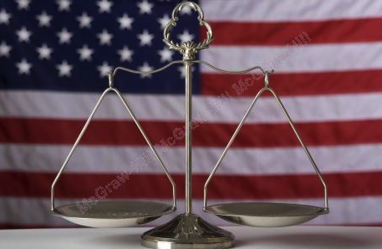
Are Ethics the Same as Laws?
Laws
Business Ethics
Notes:
Laws: society’s formal written rules about what constitutes right and wrong conduct in various spheres of life.
Ethical concepts are more complex than written rules of law.
Business Ethics: the application of general ethical ideas to business behavior.

Slide 5
Misconduct at Work
The Ethics and Compliance Initiative:
The Institute for Leadership and Management report
Notes:
The Ethics and Compliance Initiative: since 2000 about half of all employees surveyed reported ongoing observations of unethical behavior at work.
In 2017, the most common unethical practice was lying to employees and external stakeholders.
Other unethical practices included abusive behavior, Internet abuse, conflicts of interest, and health violations.
The Institute for Leadership and Management reported that 63 percent of managers expected to act unethically at some point in their careers.

Slide 6
Why Business Should be Ethical?
From Figure 5.1
Reasons for Business to be Ethical
To enhance business performance.
To comply with legal requirements.
To prevent or minimize harm.
To meet demands of business stakeholders.
To promote personal morality.
Let’s look at each reason in more depth →
Notes:
1.To enhance business performance.
Research shows strong link between ethics and financial performance.
Ethical actions can directly affect their organization’s bottom line.
2.To comply with legal requirements.
Two legal requirements provide direction for companies interested in being more ethical in their business operations:
U.S. Corporate Sentencing Guidelines.
Sarbanes-Oxley Act of 2002.
3.To prevent or minimize harm.
Overriding principle that business should “do no harm.”
4.To meet demands of business stakeholders.
Consumers are more inclined to purchase the products.
Signaling a long-term concern for all stakeholders; a better economic performance.
Gain the trust from the investors.
5. To promote personal morality.
Knowing one works in a supportive ethical climate contributes to sense of psychological security.

Slide 7
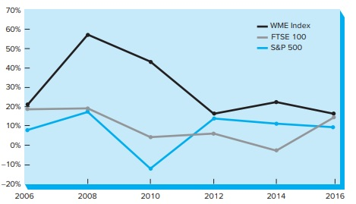
The World’s Most Ethical Index versus
S&P 500 and FTSE 100, 2006–2017
Copyright © McGraw-Hill Education. Permission required for reproduction or display.
Figure 5.2
Access the text alternative for these images.

Slide 8
U.S. Corporate Sentencing Guidelines
Establish standards and procedures to reduce criminal conduct.
Assign high-level officer(s) responsibility for compliance.
Not assign discretionary authority to “risky” individuals.
Effectively communicate standards and procedures through training.
Take reasonable steps to ensure compliance—monitor and audit systems, maintain and publicize reporting systems.
Enforce standards and procedures through disciplinary mechanisms.
Following detection of offense, respond appropriately and prevent reoccurrence.

Slide 9
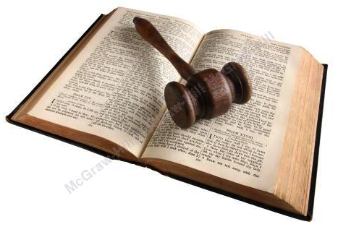
Sarbanes-Oxley Act of 2002
Born from the ethics scandals at Enron, WorldCom, Tyco and others.
Seeks to ensure that firms maintain high ethical standards.
  How they conduct and monitor business operations.
Requires executives to:
  Vouch for the accuracy of a firm’s financial reports.
  Pay back bonuses based on earnings that are later proved fraudulent.
Established strict rules for auditing firms.

Slide 10

Consider:
Why Ethical Problems Occur in Business1
What are the Core Elements of Ethical Character:
Managers’Values
Core Elements of Ethical Character:
Spirituality in the Workplace
Notes:
Why ethical problems occur - Four Primary Reasons:
Personal gain and selfish interest.
Competitive pressure on profits.
Conflicts of interest.
Cross-cultural contradictions.
Core Elements of Ethical Character:
Managers’Values Serve as models for others who work at the company.
New CEOs tend to be more self-interested and short-term focused.
Recent study: today’s managers place slightly more importance on moral values > competency values.
The challenge for many moral managers is acting effectively on their beliefs in the day-to-day life of their organizations.
Core Elements of Ethical Character: Spirituality in the Workplace
Personal belief in a supreme being, religious organization, power of nature or some other life-guiding force.
Organizations accommodate their employees to meet their spiritual and religious needs.
Opponents of spirituality at work argue to keep spirituality out of the workplace.

Slide 11
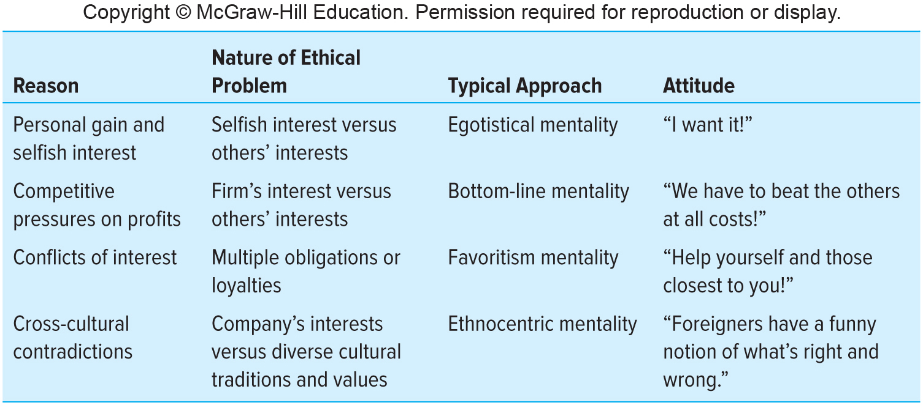
Why Ethical Problems Occur in Business2
Figure 5.3
Copyright © McGraw-Hill Education. Permission required for reproduction or display.
Access the text alternative for these images.

Slide 12
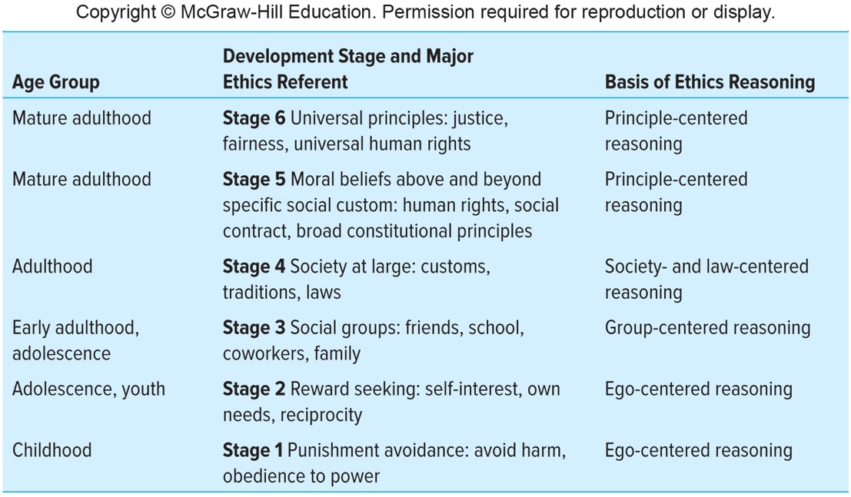
Stages of Moral Development and
Ethics Reasoning
Copyright © McGraw-Hill Education. Permission required for reproduction or display.
Figure 5.4
Access the text alternative for these images.
Notes:
Stages of Moral Development:
From childhood to mature adulthood people move up in their moral reasoning
Stage 1: Earliest stages of reasoning are ego-centered
Stage 2: “I’ll let you play with my toy, if I can play with yours”
Stage 3: Learn the give-and-take
Stage 4: Able to focus their reasoning according to law
Stage 5: Apply their moral beliefs above and beyond specific social custom
Stage 6: Emphasize ethical reasoning using broad principles and relationships
Most managers make decisions based on criteria in levels three and four.
Senior leaders often demonstrate higher stages of moral reasoning than typical managers.
Company executives’ reasoning has wide implications both inside and outside the organization.

Slide 13
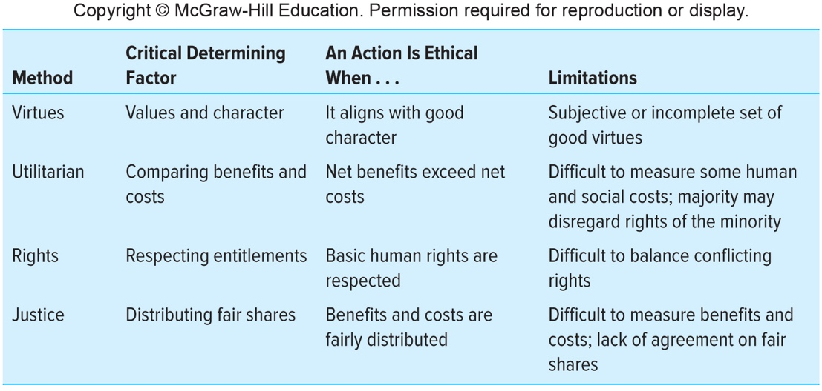
Four Methods of Ethical Reasoning
Figure 5.5
Copyright © McGraw-Hill Education. Permission required for reproduction or display.
Access the text alternative for these images.
Notes:
Analyzing Ethical Dilemmas in Business
A set of decision guidelines that will aid thinking process when on-the-job ethics issues occur.
These guidelines should help them:
Identify and analyze the nature of an ethical problem.
Decide which course of action is likely to produce an ethical result.
Virtue Ethics: Character traits that a good person should posses, theorizing that moral values will direct the person toward good behavior.
Virtue ethics is not a thoroughly developed ethical system of rules and guidelines, but rather a system of values that form good character.
Utilitarian reasoning: overall amount of good that can be produced by an action or a decision.
Compare benefits and costs of a decision, policy or action.
Costs and benefits can be economic, social or human.
Drawbacks:
The difficulty of accurately measuring both costs and benefits.
The majority may override the rights of those in the minority.
Human Rights: Person or group is entitled to something or to be treated in a certain way.
Examples of basic human rights are right to life, safety, and due process.
Limitations:
The difficulty of balancing conflicting rights.
Justice: benefits and burdens are distributed equally, according to some accepted rule.
Social Justice: society’s income and wealth are distributed among the people in fair proportions.
Fair shares will vary from person to person and group to group.

Slide 14
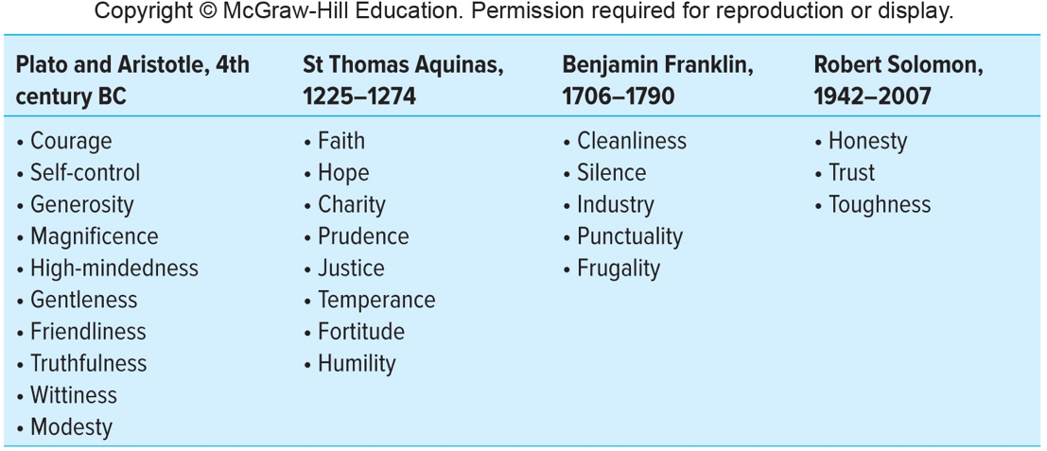
List of Moral Values Across Time
Figure 5.6
Copyright © McGraw-Hill Education. Permission required for reproduction or display.
Access the text alternative for these images.

Slide 15

Applying Ethical Reasoning to Business Activities
Once the ethical analysis is complete, the decision maker should ask the question:
Do all of the above ethics approaches lead to the same decision?
Notes:
Once the ethical analysis is complete, the decision maker should ask the question:
Do all of the above ethics approaches lead to the same decision?
If all the answers are “Yes”, the proposed action is ethical.
If all the answers are “No”, the action is not ethical and needs to be reconsidered.
If “Yes” and “No” answers are mixed, you must decide which takes priority.

Slide 16
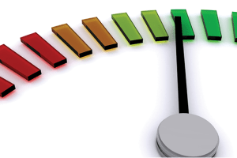

Moral Intensity: Five Dimensions
Magnitude of consequences.
Proximity.
Social consensus.
Probability of effect.
Temporal immediacy.
Notes:
Moral Intensity: One concept for determining the ethicality or morality of a situation.
Moral intensity is the extent of the issue-related moral imperative in a situation.
Magnitude of Consequences: the sum of the harms/benefits done to the victims/beneficiaries of the moral act.
Found to be the most powerful dimension.
Proximity: The feeling of nearness (social, psychological, physical) that the moral act has for the victims/beneficiaries.
Found to be a powerful dimension.
Social Consensus: The degree of social agreement that a proposed act is evil/good.
Seems to be more like “social concern”.
Found to be a powerful dimension.
Probability of Effect: Probability that the act will take place and the act will cause the harm/benefit predicted.
Found to be a powerful dimension.
Temporal Immediacy: length of time between the present and the onset of the consequences.
NOT found to be the most powerful dimension.

Slide 17
Ethics and Ethical Reasoning
Chapter 5
Copyright ©2020 McGraw-Hill Education. All rights reserved. Authorized only for instructor use in the classroom. No reproduction or further distribution permitted without the prior written consent of McGraw-Hill Education.

